Slide 1
Player Too: A Secondary Journey
Lewanika Pittman
Amro Tayeb
Senior Project I
Advisor: Dr. Erdem Erdemir
Course Instructor: Dr. Ali Sekmen

Slide 2
Introduction
We will be creating a Role-Playing Game
Using the Unity Game Development Engine

Slide 3
Goals
Create a functional 3d game
Functional AI behavior
Functional world
Work with Oculus rift

Slide 4
Objectives
Create a game Using unity
Unity coding
Ray casting
Main character and enemy model
Levels
Movements
Soundtrack
GUI
Oculus Rift
Realistic graphics

Slide 5
Functional Requirements
The game will be an RPG
The main character will be able to discover and use equipment
The main character will have a cone of vision
The player will use a secondary character

Slide 6
Non-Functional Requirements
Run in Windows 10
Stable Framerate
Quick Response time
Required Resources
Clean User Interface

Slide 7
Character Design
Main Character: The Light Knight
Your Character: Too
Enemy Designs
Simple, Cartoonish designs

Slide 8
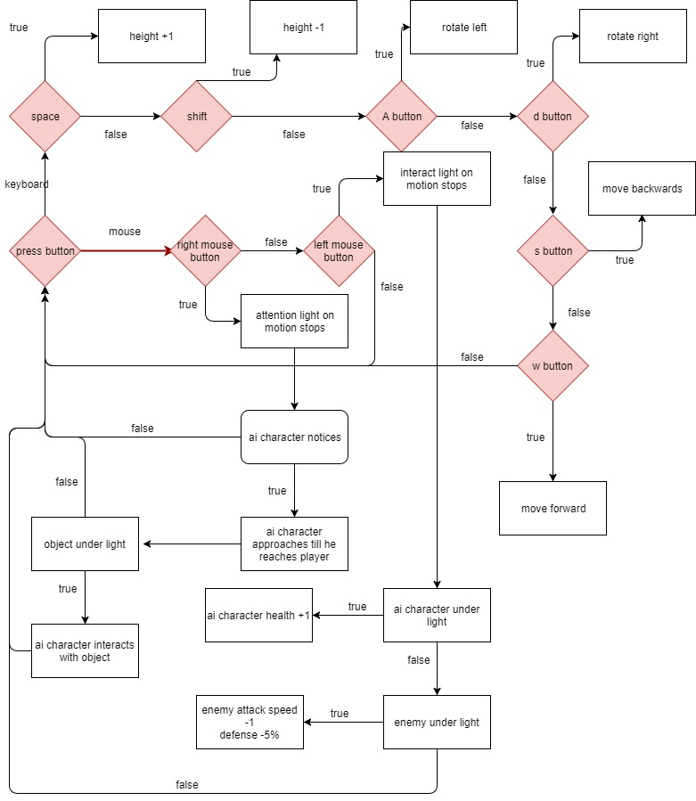
Character Design Cont….

Slide 9
Level Design
Height Map
Height Resolution Textures
Weapon Crafting
Lakes and Rivers
Traps

Slide 10
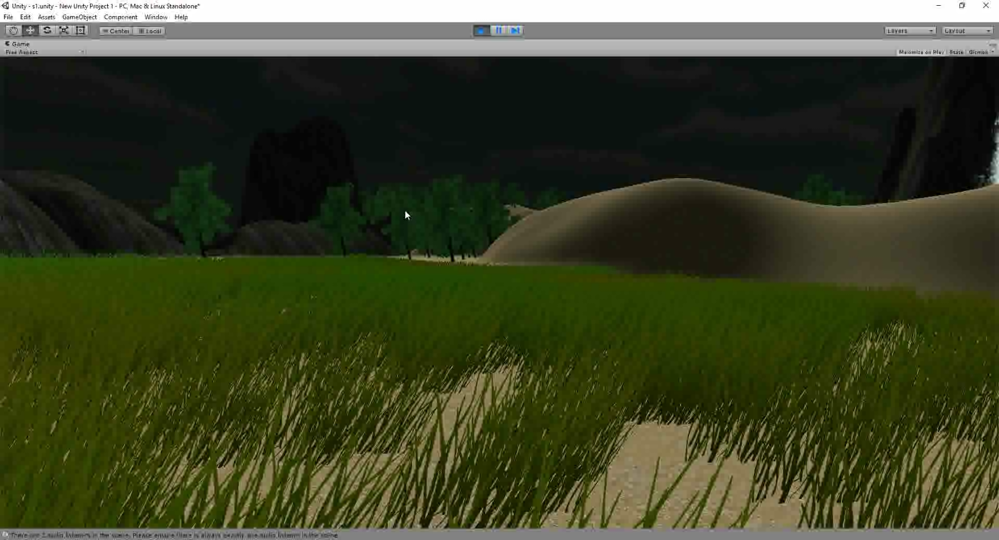
Level Design Cont….

Slide 11
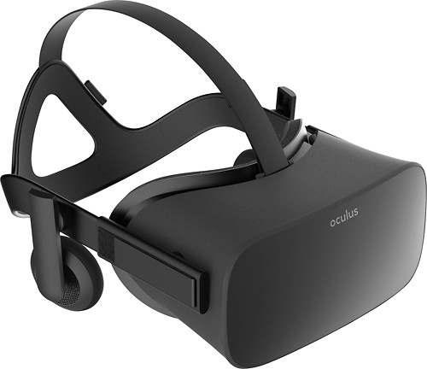
Virtual Reality Integration
Will be Ported Using Unity Game Engine
Oculus Rift Compatible
Most Mechanics Same
Will be using Teleportation Method

Slide 12
Moving Forward
Finish Character Designs
Item Placement
Further Oculus Integration
Play Testing

Slide 13
Thank You!
This Concludes Our Presentation
Questions?

